Slide 1
TIMN seminar
GNSS Radio Occultation Inversion Methods
Thomas Sievert
September 12th, 2017
Karlskrona, Sweden

Slide 2
Outline
GNSS radio occultation
  Concepts
  Features and applications
  Geometry
  Abel transform
  The phase matching operator
  Overview
  Limitations
My project

Slide 3
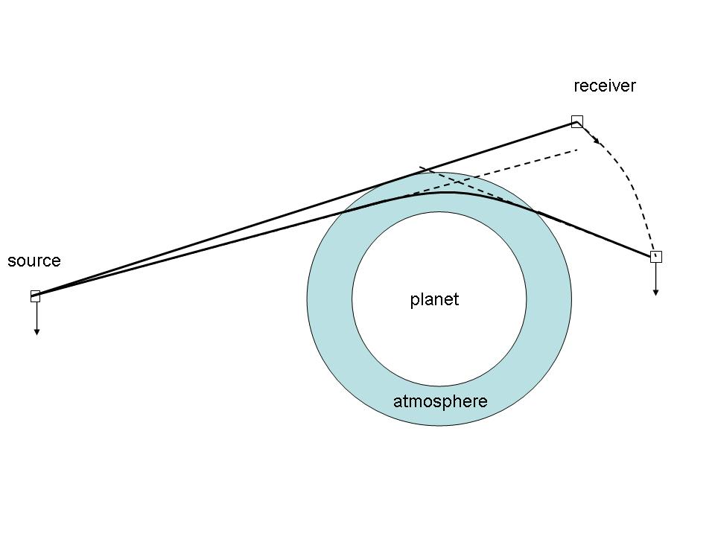
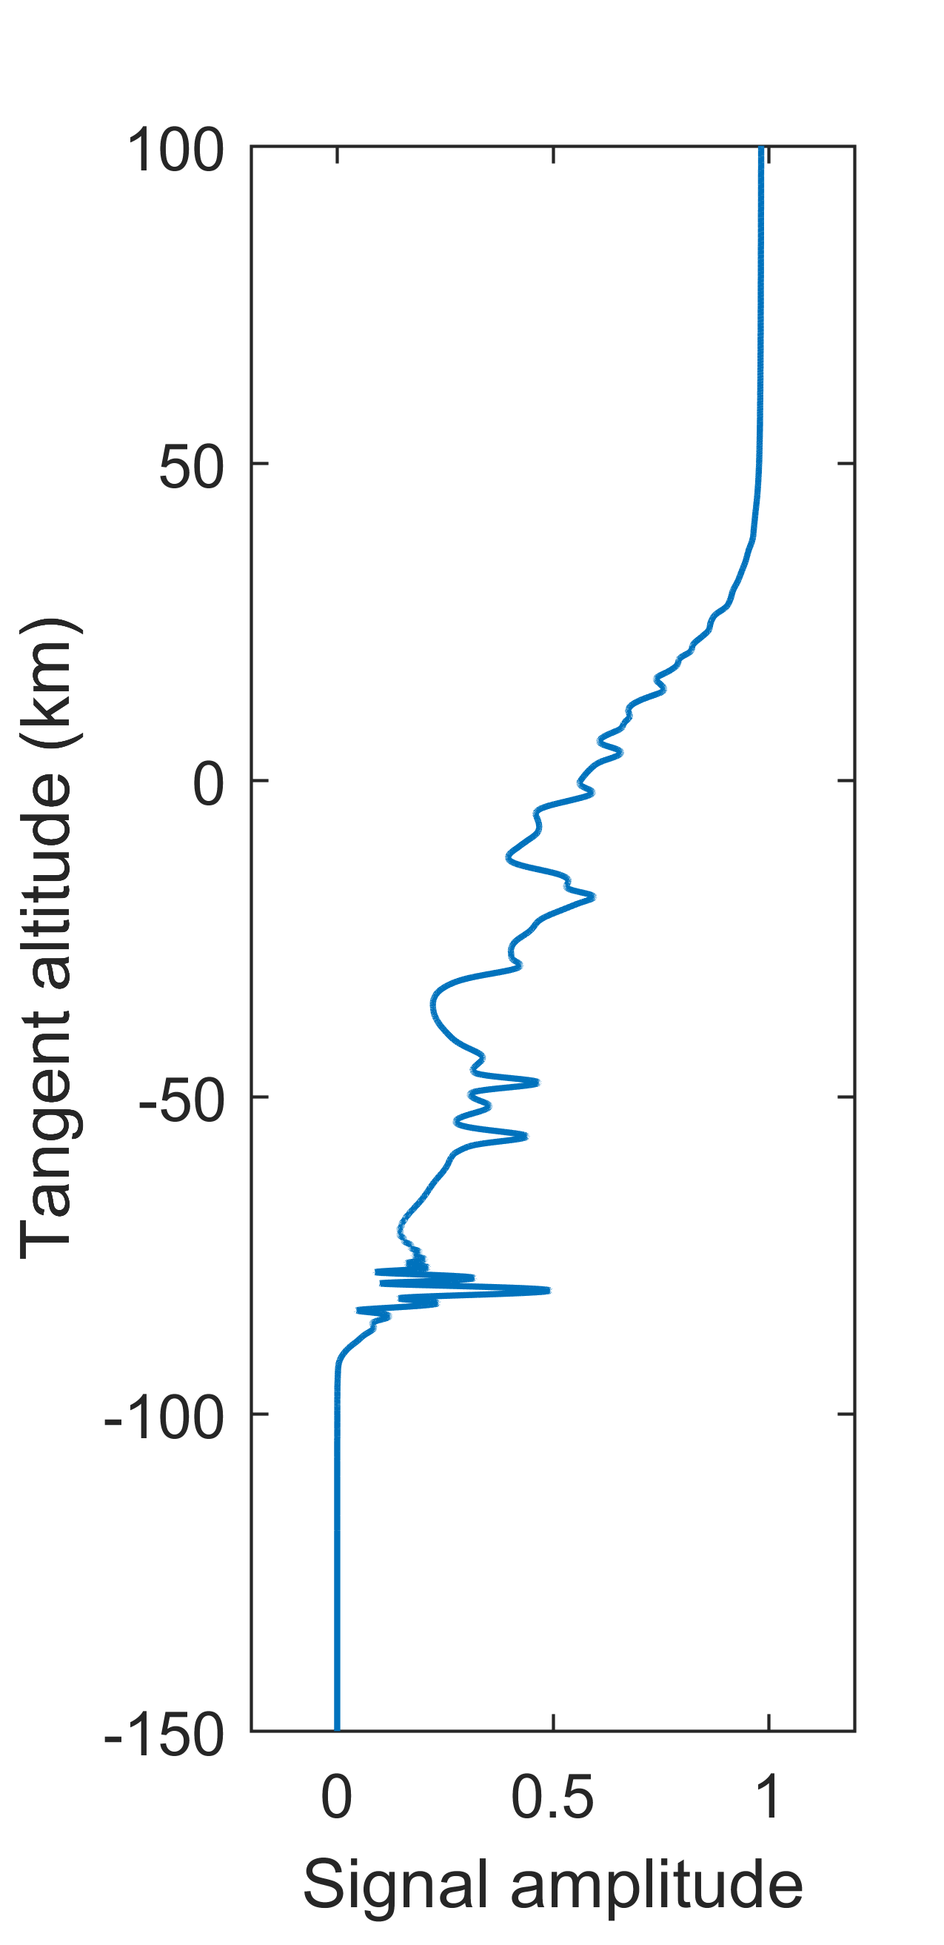
GNSS Radio Occultation:
Concept
Origin: Scanning planets’ atmospheres
Sensing the Earth…
  80’s: GPS and GLONASS
  Source: GNSS satellite
  Bending: signal refracts in the atmosphere
  Receiving: LEO satellite
Occultation event:
Source: Wikipedia

Slide 4
GNSS Radio Occultation:
Features and Applications
Pressure
Temperature
Doppler shift
Bending Angle
Refractivity
Humidity
Electron Density

Slide 5
GNSS Radio Occultation:
Features and Applications
High precision and vertical resolution
  Resolve small structures
Low sensitivity to clouds or precipitation
Potential of global coverage
  Oceans
  Polar zones
Assimilation of RO data in Numerical Weather Prediction (NWP)
  TOP 5 techniques in forecast error reduction (source: ECMWF)
Severe Weather Forecasting
  Tornado, typhoons

Slide 6

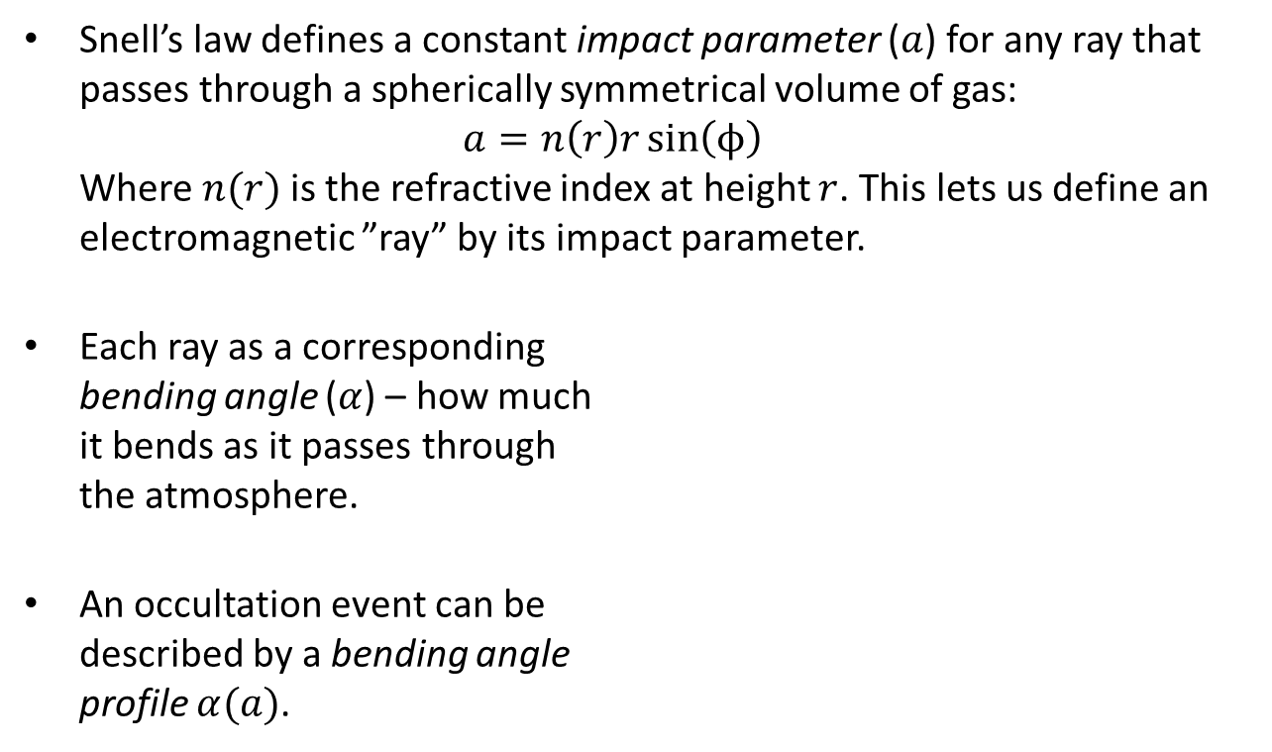


GNSS Radio Occultation:
Geometry
Snell’s law defines a constant impact parameter ($a$) for any ray that passes through a spherically symmetrical volume of gas:
$a=n\left(r\right)r\sin\left(ϕ\right)$
Where $n(r)$is the refractive index at height $r$. This lets us define an electromagnetic ”ray” by its impact parameter.
Each ray as a corresponding
bending angle ($α$) – how much
it bends as it passes through
the atmosphere.
An occultation event can be
described by a bending angle
profile $α(a)$.
$$α$$
$$ϕ$$
$$r$$

Slide 7
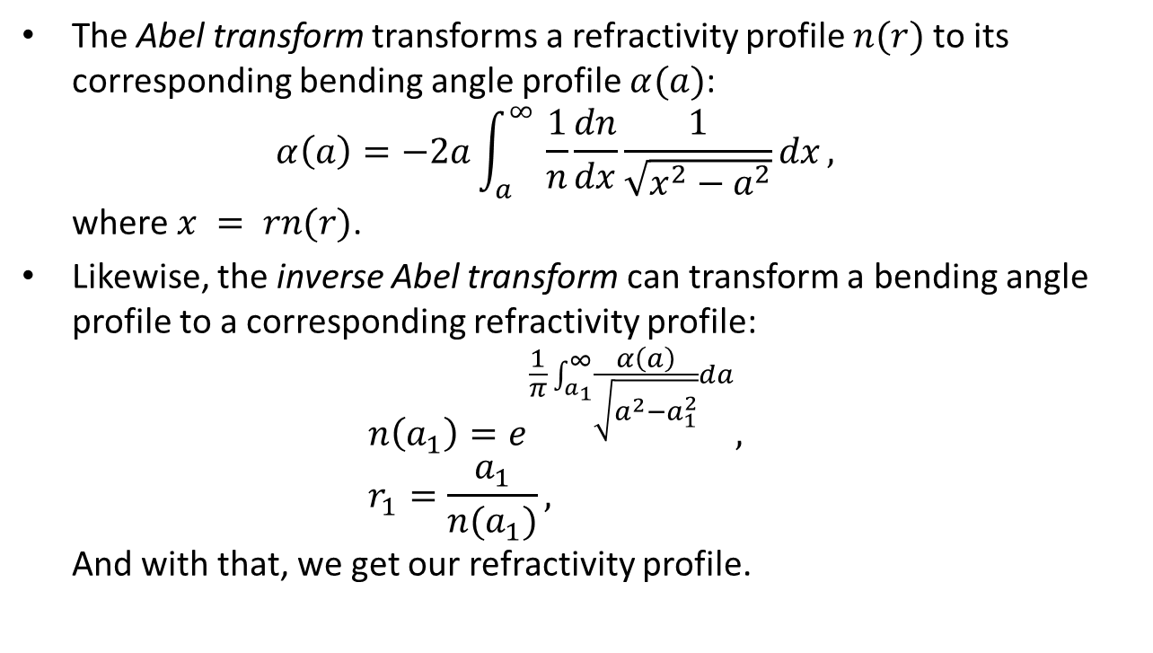
GNSS Radio Occultation:
The Abel transform
The Abel transform transforms a refractivity profile $n(r)$to its corresponding bending angle profile $α(a)$:
$α\left(a\right)=−2a\int_{a}^{∞ }{\frac{1}{n}\frac{dn}{dx}\frac{1}{\sqrt{x^{2}−a^{2}}}dx},$
where $x = rn(r)$.
Likewise, the inverse Abel transform can transform a bending angle profile to a corresponding refractivity profile:
$n\left(a_{1}\right)=e^{\frac{1}{π}\int_{a_{1}}^{∞}{\frac{α\left(a\right)}{\sqrt{a^{2}−a_{1}^{2}}}da}},$
$r_{1}=\frac{a_{1}}{n(a_{1})},$
And with that, we get our refractivity profile.

Slide 8
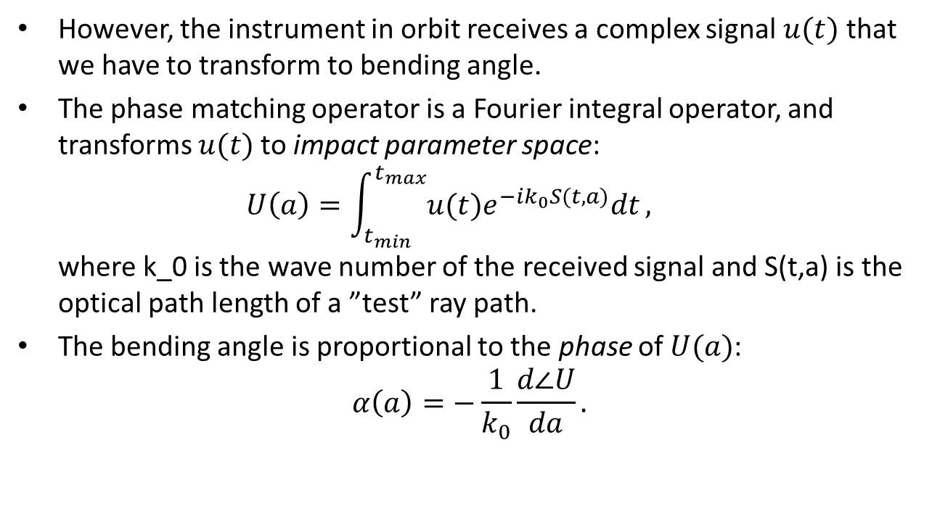
GNSS Radio Occultation:
The phase matching operator
However, the instrument in orbit receives a complex signal $u(t)$ that we have to transform to bending angle.
The phase matching operator is a Fourier integral operator, and transforms $u(t)$to impact parameter space:
$U\left(a\right)=\int_{t_{min}}^{t_{max}}{u(t)e^{−ik_{0}S(t, a)}dt},$
where k_0 is the wave number of the received signal and S(t,a) is the optical path length of a ”test” ray path.
The bending angle is proportional to the phase of $U(a)$:
$α\left(a\right)=−\frac{1}{k_{0}}\frac{d∠U}{da}.$

Slide 9
GNSS Radio Occultation:
Overview
Received signal
Phase matching
Inverse Abel transform
Refractivity profile

Slide 10
GNSS Radio Occultation:
Limitations
Spherical symmetry – good vertical resolution but can’t resolve horizontal structures.
The inverse Abel transform assumes a strictly decreasing refractivity profile.
Super-refraction – when a ray bends as much as the Earth’s curvature it ”gets stuck”.

Slide 11
My project
Super-refraction
If the refractivity gradient is too sharp, there will be infinitely many refractivity profiles that produce the same bending angle profile.
The inverse Abel transform will always yield the ”smallest” of them, resulting in a negative bias:
The purpose of my project is to address this bias and – hopefully – remove it.

Slide 12
My project
Current approach
While normally we only use the phase of the phase matching output, I’m interested in the amplitude.
Might contain additional information about the impact parameter at Earth’s surface, at the beginning of the super-refractive layer, and maybe even about horizontal gradients in the atmosphere.
Such information could let us make parametric reconstructions without the inverse Abel transform.

Slide 13
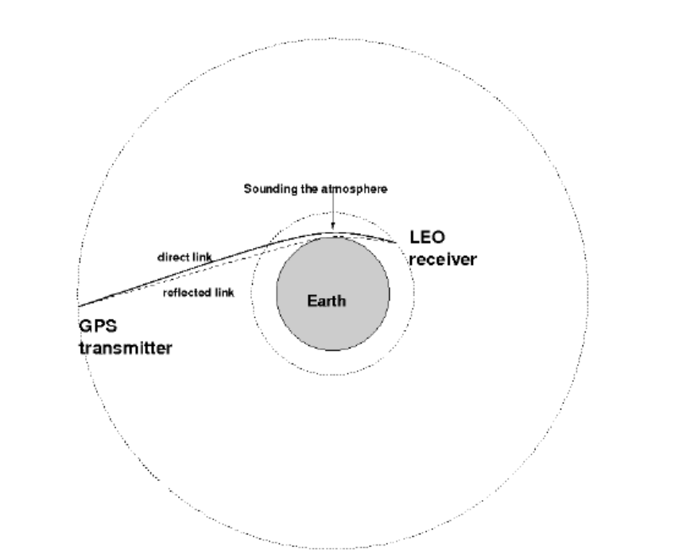
My project
Surface reflections
GNSS signals are reflected in the ocean.
Reflected signals contain additional
information.
Usually detected as a Doppler shift.

Slide 14
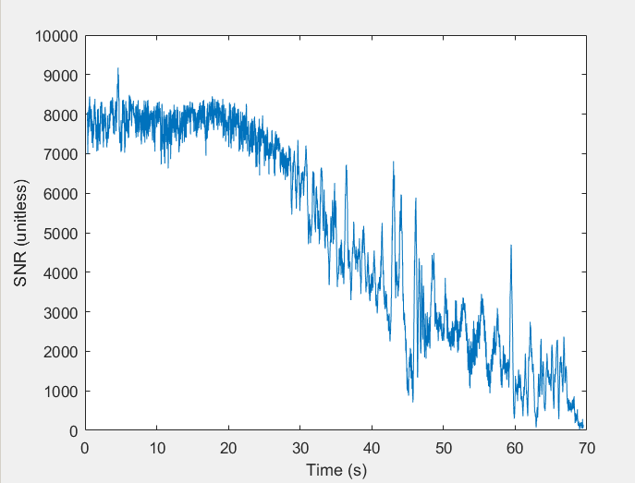
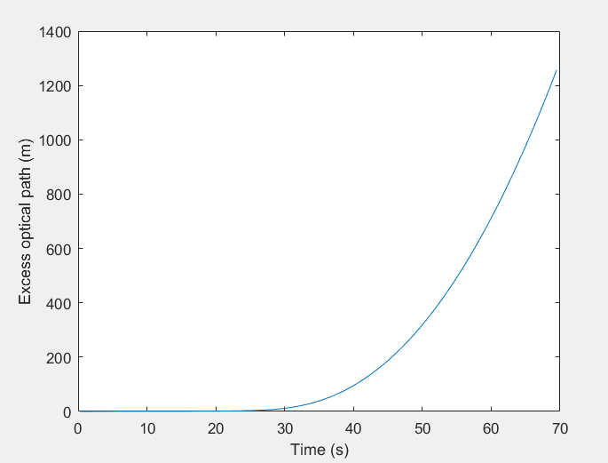

My project
Surface reflections
A RO signal can be represented as an electromagnetic field along a parametric orbit, $E(t)$, which we can write as $A\left(t\right)e^{iφ(t)}$.
– the amplitude – is the signal to noise ratio (SNR).
$φ(t)$ – the phase – is the excess optical path of the signal.

Slide 15
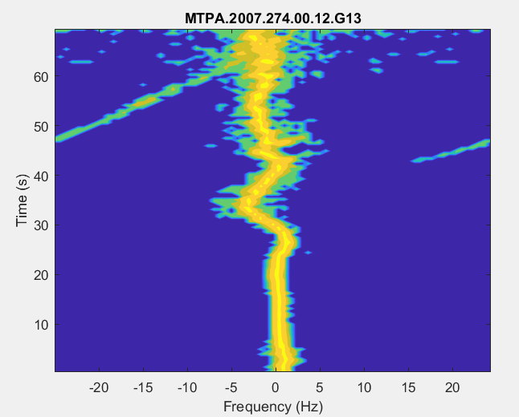
My project
Surface reflections
If we subtract the excess path of a typical atmosphere, we can use the short-time Fourier transform to detect reflected components:
The central part is the direct
signal.
The highlighted area shows the
Doppler shift typical to a surface
reflection.
I use a different approach!

Slide 16
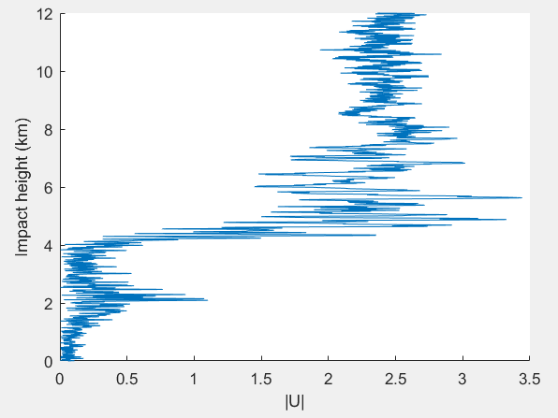
My project
Surface reflections
Phase matching gives an amplitude for each individual ray:
The red box highlights the lowest
direct rays in the measurement.
The green box highlights reflected
rays.
Direct rays at that impact height
would require a deeper
measurement!
In deeper measurements, the
contribution of direct rays overlaps
with the reflected ones.
My current paper is about finding such ”reflection spikes” in deep measurements to detect reflected signals.

Slide 17
Thank you for your attention!

