Slide 1
Triangular magic
Heron triangles (sides), and commensurable triangles (angles),
but mostly commensurable triangles
Håkan Lennerstad, BTH

Slide 2
3
A rational triangle.
2
4
3
2
h = V5/8
4
1
1
Heronian triangle: rational sides and rational area
(⇔ all heights rational, since A = bh/2) .
1

Slide 3
First: Pythagorean triangles, which have integer sides and
a right angle.
3
3
4
3² + 4² = 9 + 16
5² = 25
”Egyptian”
4
h
5
5
5² + 12² = 25 + 144
13² = 169
(m² – n²)² + (2mn)² = (m² + n²)²
All pythagorean triangles: k(m² – n²), k2mn, k(m² + n²),
Integers k, m, n m > n.
(3, 4, 5) gives k=1, m=2, n=1.
(5, 12,13) gives k=1, m=3, n=2.
And so on.
Third height?
Heronian triangles that are not right triangles?
5h/2 = 3∙4/2.
So h = 12/5 = 2,4.
From area:

Slide 4
13
5
5
3
4
12

Slide 5
13
5
4
12
3
5

Slide 6
13
5
12

Slide 7
13
25/4
5
5
12
15/4
Gives heronian (13, 12 + 15/4, 25/4)-triangle.
Gives heronian (52, 63, 25)-triangle.
So: all heights are rational: A = ah₁/2 = bh₂/2 = ch₃/2.

Slide 8
4
5
3
3
5
4
Gives heronian (5,5,8)-triangle.
And (5,5,6).
5
3
4
3
4
5
All heronians come from a pair of pythagoreans.

Slide 9
That was triangles by sides. Now triangles by angles!
The angles of a commensurable triangle relate as integers, say n, m and k.
𝜋/3
Which are relatively prime. Commensurable triangles correspond to integer triples.
𝜋/3
𝜋/3
Then the angles are
n𝜋/(n + m + k), m𝜋/(n + m + k) and k𝜋/(n + m + k),
making the angle sum 𝜋.
The angle 𝜋/(n + m + k) is the root angle – the largest angle dividing all three.
The generation of the triangle (n, m, k) is n + m + k.
Two assumptions on the triple: 1. n, m and k are relatively prime, 2. n ≤ m ≤ k.
Are these interesting triangles?
The commensurable triangles form a dense set among the set of triangles,
when disregarding size (by for example set the area = 1)?
Triangle tree: the child of n-m-k is obtained by adding 1 to n, m or k, as long as the two assumptions are fulfilled. At most three children.
The generation number of a commensurable triangle is n + m + k.

Slide 10
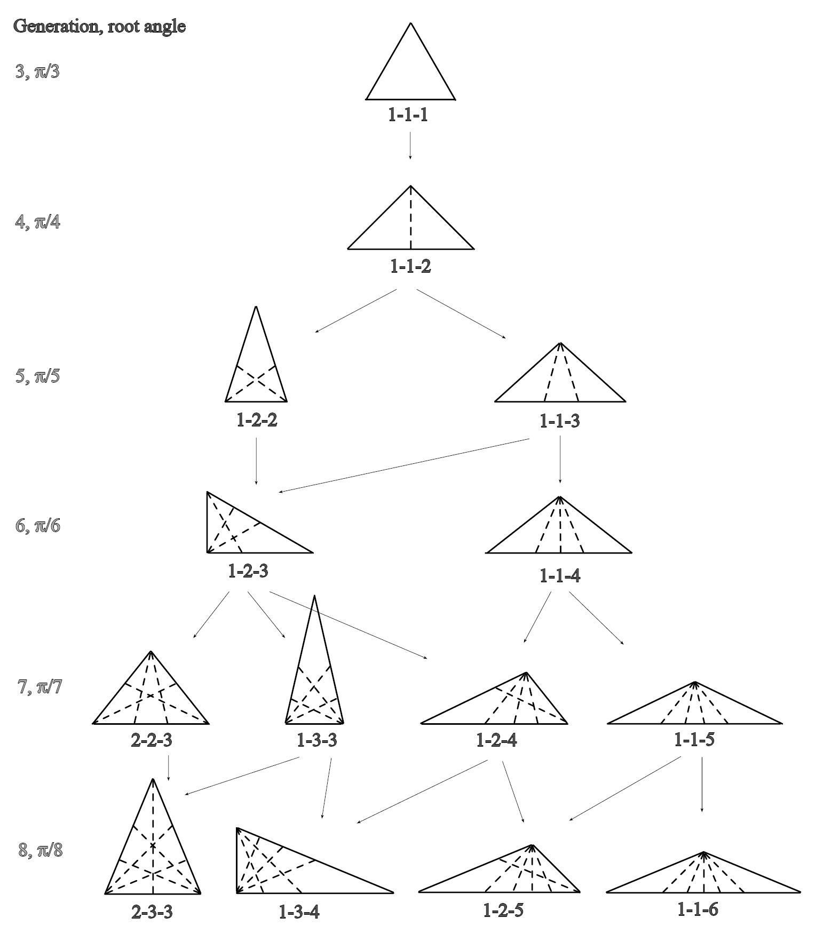

Slide 11
Property correspondence
𝜋/3
commensurable triangle Integer triple n, m, k
𝜋/3
𝜋/3
Right n + m = k
Wide isosceles n = m
Narrow isosceles m = k
Equilateral n = m = k ( =1)
Partition of integer: write as a sum of positive integers.
1 = 1 (1 way)
2 = 2 = 1 + 1 (2 ways)
Only odd numbers distinct numbers
1 1
1 1
3 = 3 = 2 + 1 = 1 + 1 + 1 (3 ways)
2 2
4 = 4 = 3 + 1 = 2 + 2 = 2 + 1 + 1 = 1 + 1 + 1 + 1 (5 ways)
2 2
5 = 5 = 4 + 1 = 3+ 2 = 3 + 1 + 1 = 2 + 2 + 1 = 2 + 1 + 1 + 1 = 1 + 1 + 1 + 1 (7 ways)
3 3
6 = 6 = 5 + 1 = 4+ 2 = 3 + 3 = 4 + 1 + 1 = 3 + 2 + 1 = 2 + 2 + 2 = 3 + 1 + 1 + 1 = 2 + 2 + 1 + 1 =2 + 1 + 1 + 1 + 1 = 1 + 1 + 1 + 1 + 1 + 1 (11 ways)

Slide 13
Q1: Can a branch end?
Q2: Will all integer triples appear?
A1,1: Is always one of the triples (a + 1, b, c) and (a, b + 1, c) and (a, b, c + 1) relatively prime?
A1,2: If (a + 1, b) and (a, b + 1) are not relatively prime, then
A1,3: a + 1 = Ab’, where b’ is a factor in b. And
A1,4: And b = Bb’. This gives
A1,5: (A – B)b’ = 1.
A1,6: Which forces b’ = 1.
A1,7: So if a + 1, b and a, b+1 are not relatively prime, then a and b are relatively prime.
A1,8: So then a, b, c + 1 relatively prime.
A1,9: Q1 answered: No!
A2,1: One of the triples a - 1, b, c and a, b - 1, c and a, b, c - 1 relatively prime. (Similar proof.)
A2,2: Q2 answered: Yes!

Slide 14
Number of commensurable triangles of generation g? This is g_{n}. g₃ = 1, g₄ = 1, g₅ = 2, g₆ = 2, …
Same as the number of partitions of the integer g in three terms.
Consider regular polygon with n corners.
Number of distinct triangles by connecting corners: p_{n}.
All are rational with root angle 𝜋 /n, at most.
Since some belong to an earlier generation.
Formula: p_{n} = [(n-3)/6] (n – 3 [(n-3)/6] ) + 𝜏_{n mod 6}
p₆ = 3.
Where 𝜏_{n} = 3, 4 ,5, 1, 1 ,2 (for n= 0, 1, 2, 3, 4, 5).
And g_{n} = p_{n} – (sum of all g_{n/k} were k|n, n/3 ≤ k <n).
p₃ = 1.
g₆ = p₆ – p₃ = 3 – 1 = 2.

Slide 16
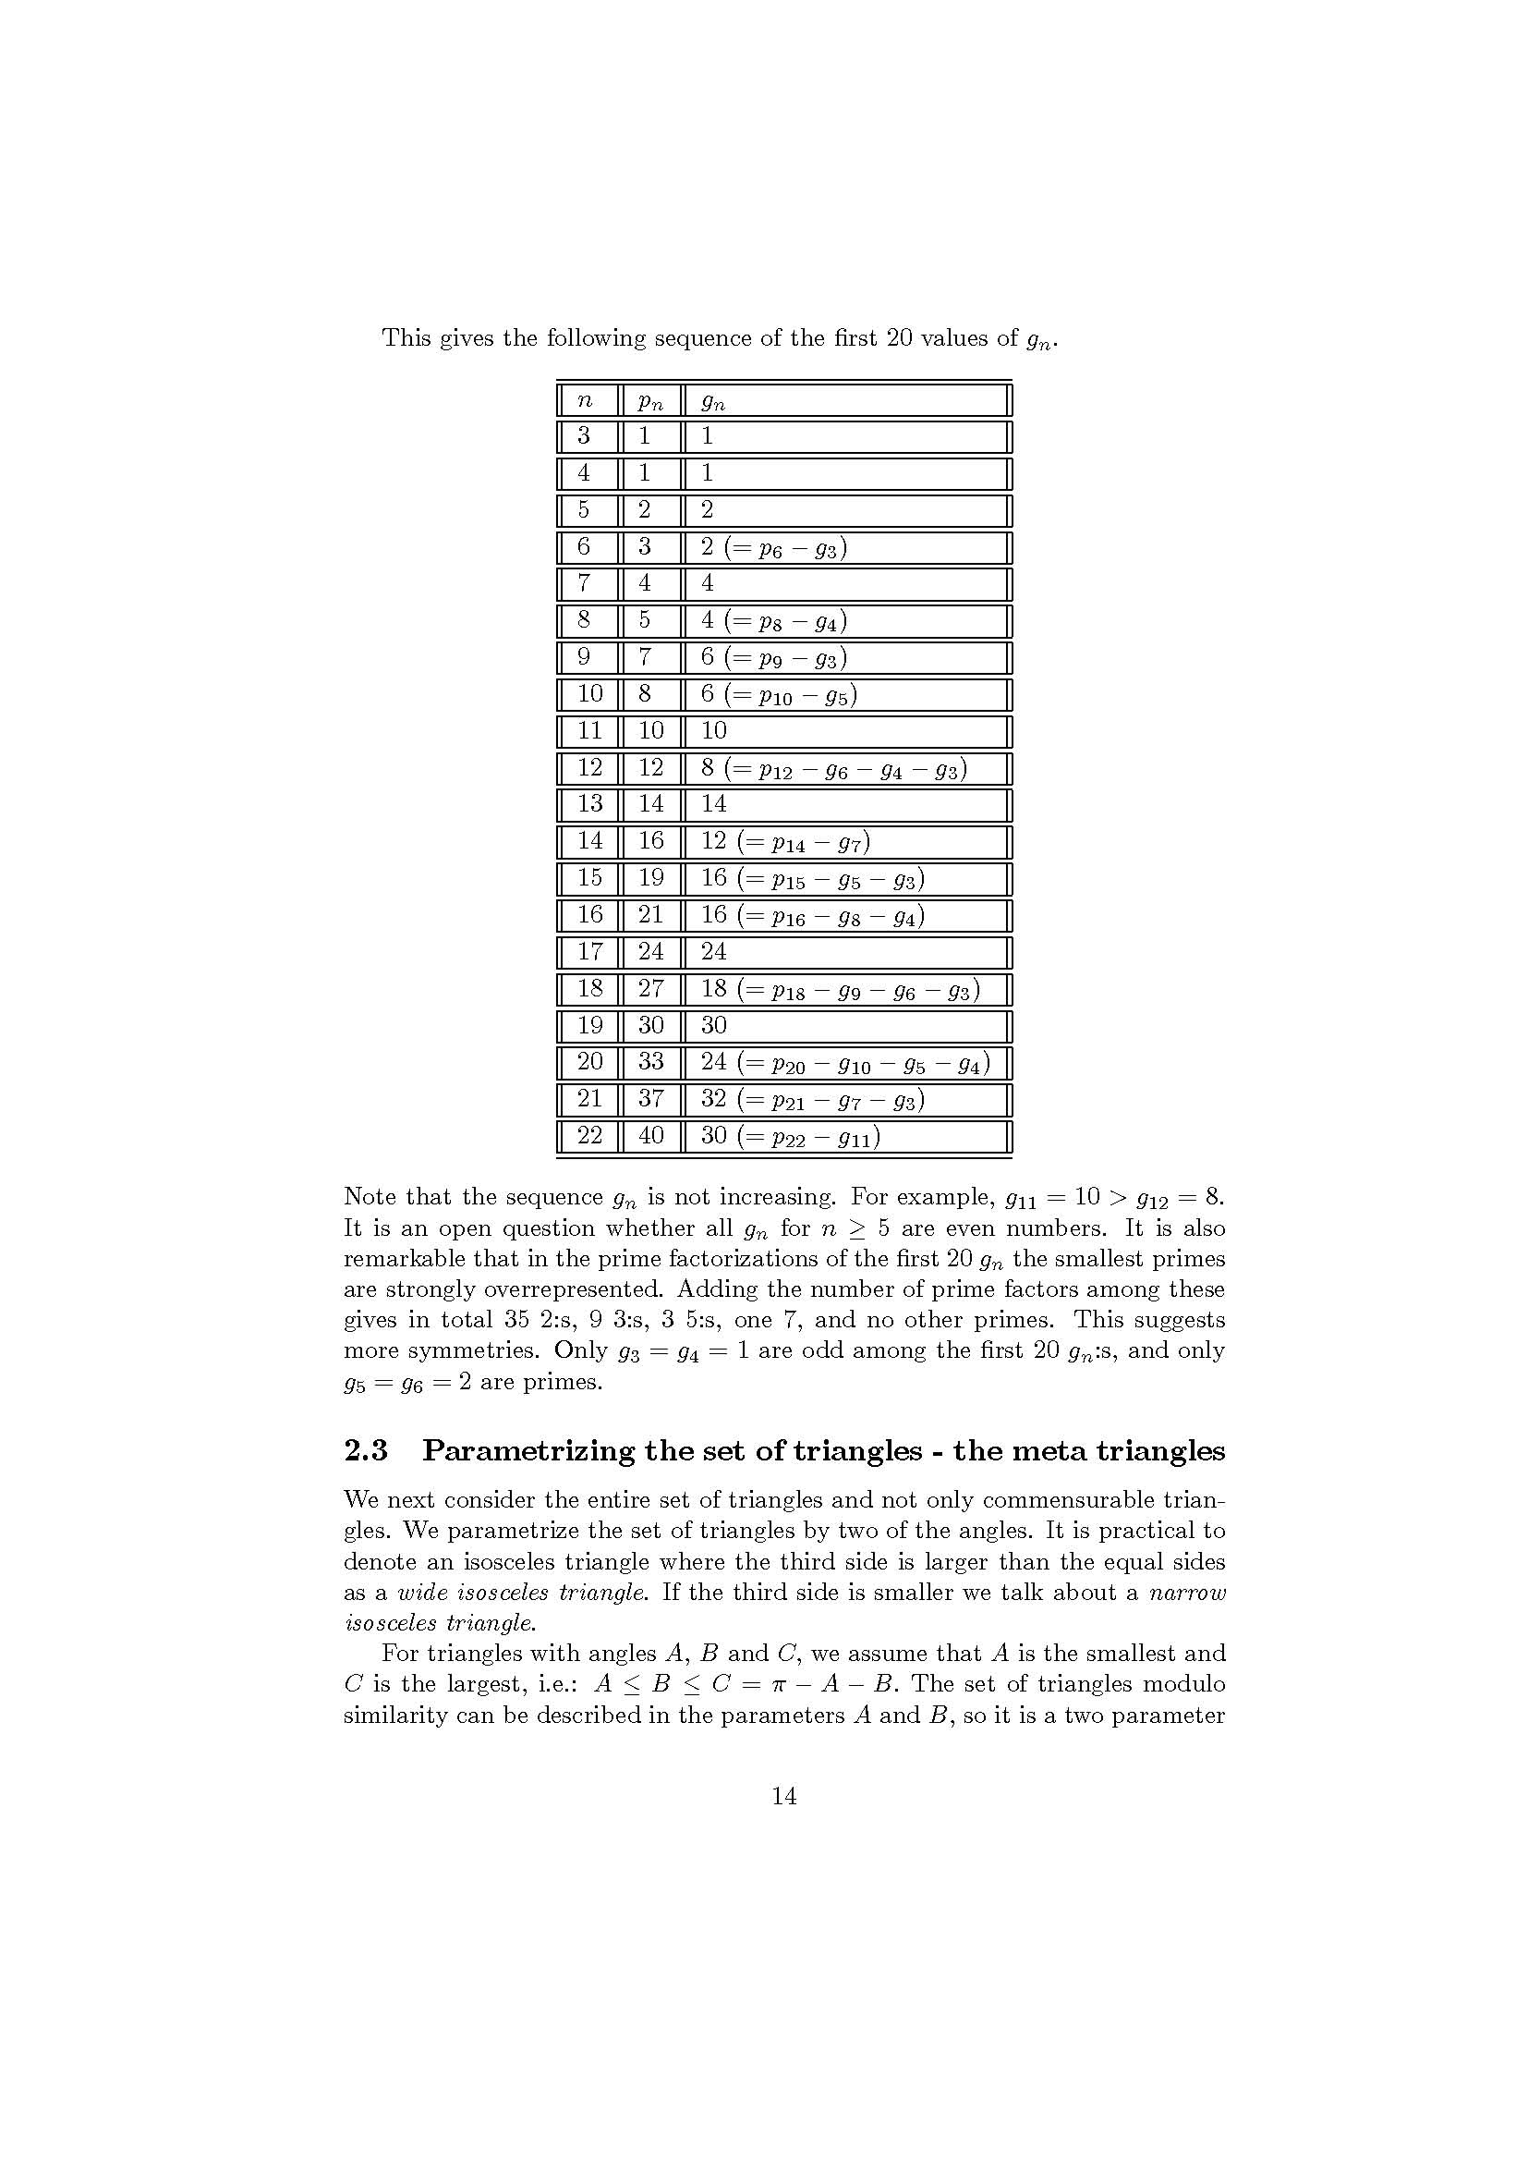

Slide 17
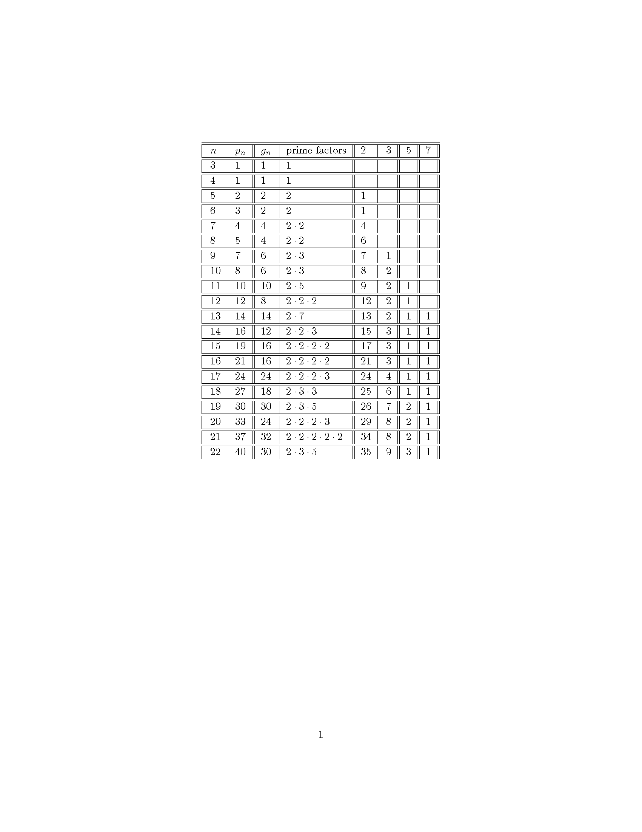

Slide 18
Puzzling observations
1. So many numbers with lots of 2:s! And many 3:s.
2. If n = p a prime, then g_{p} ≥ g_{p+1} . Why??
Hints about unseen symmetries…
Unseen, yet!

Slide 19
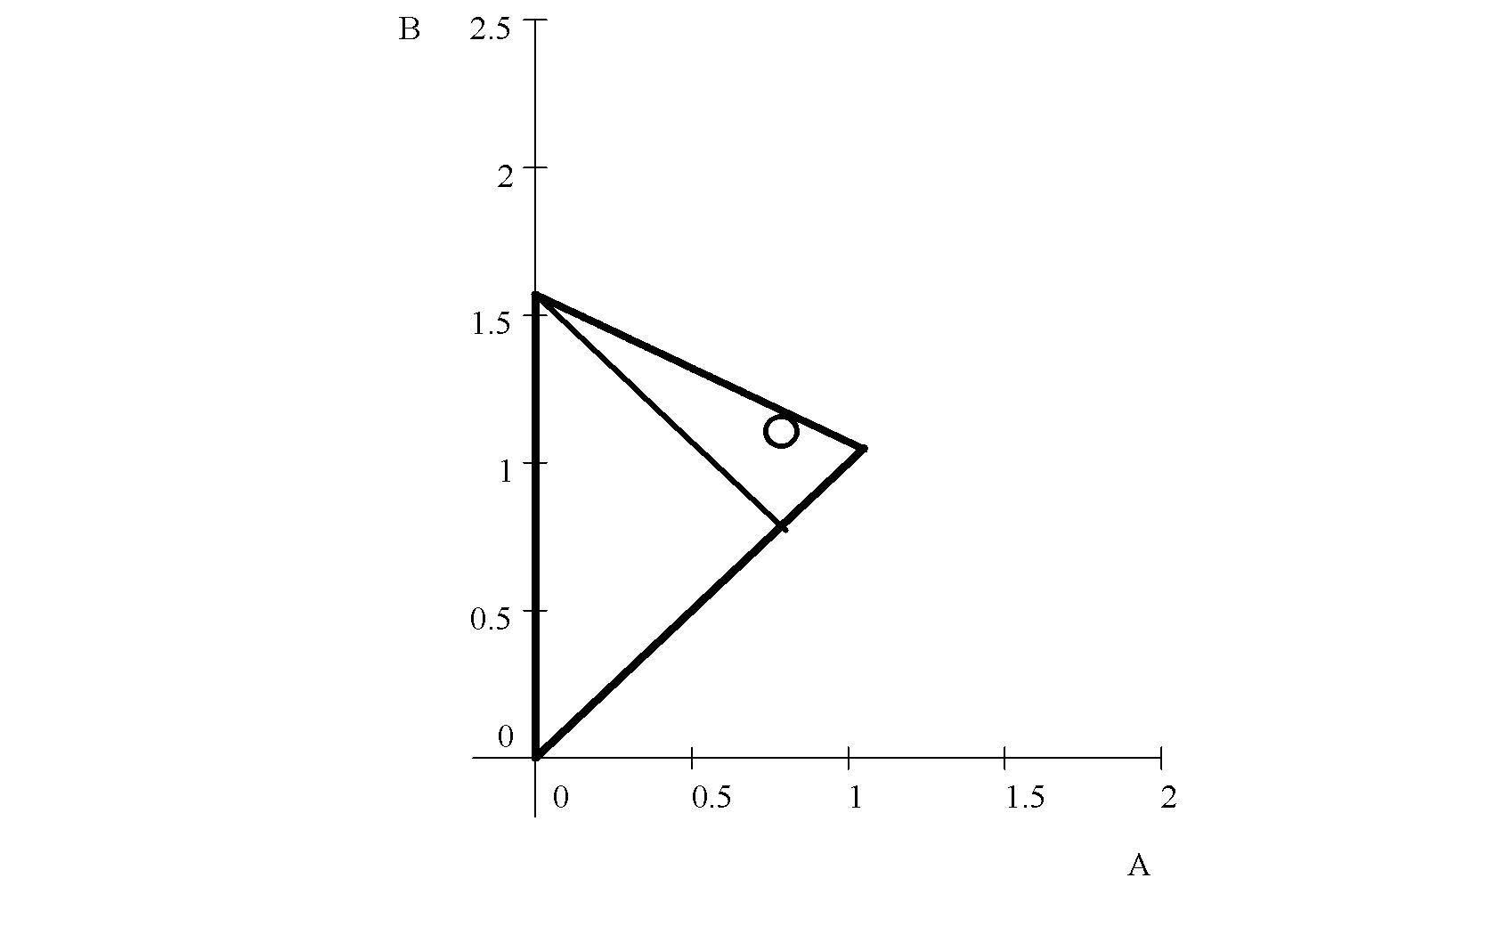

Slide 20
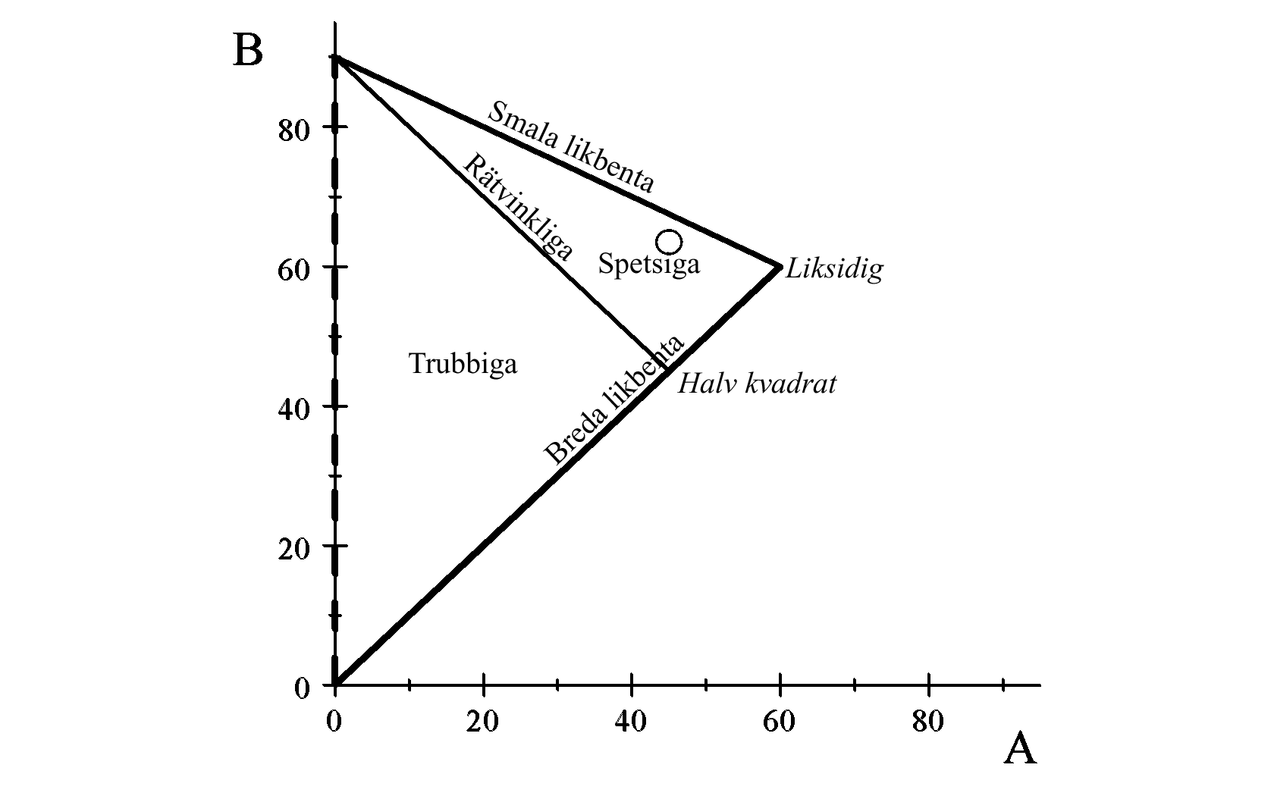

Slide 23
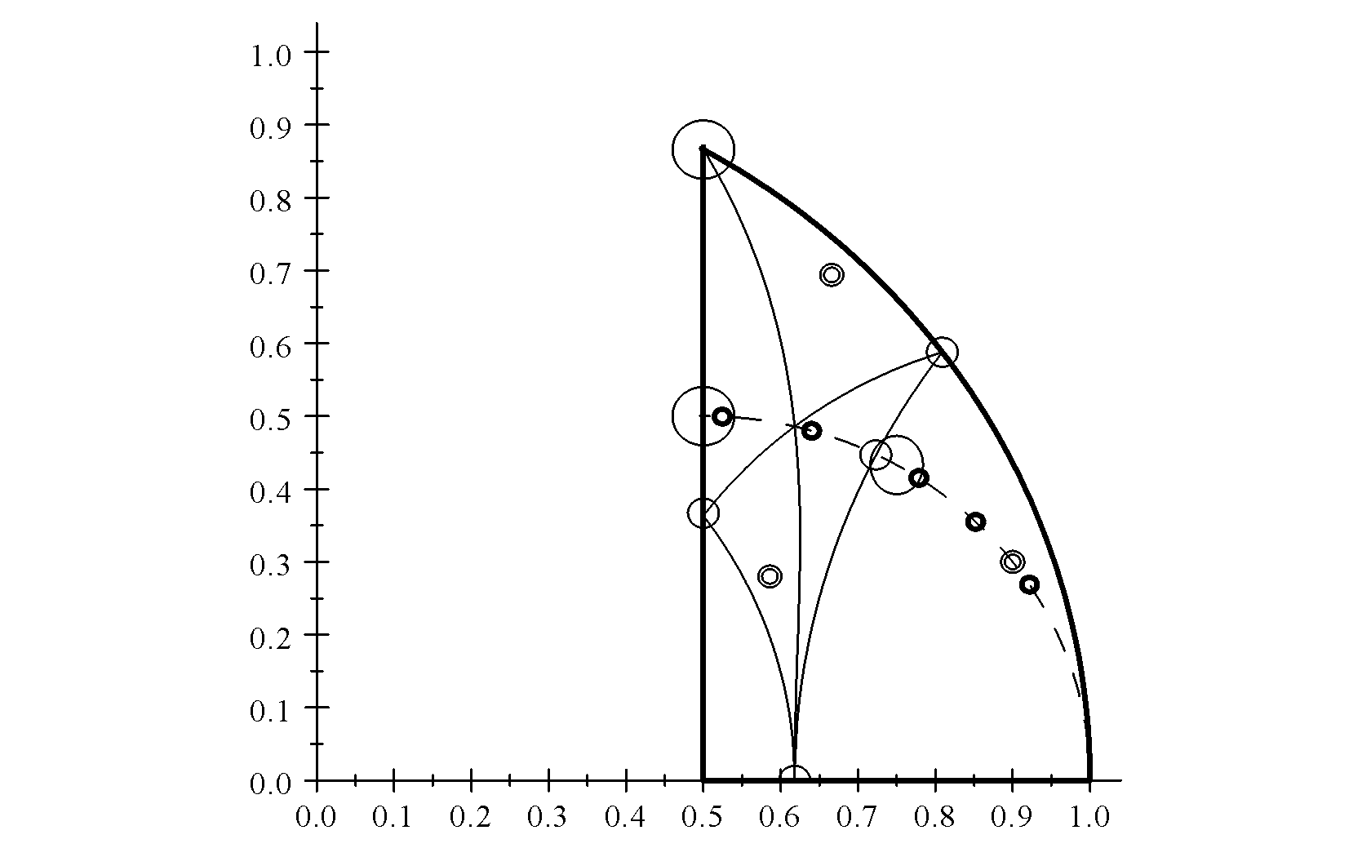
Thank your for your attention!
To be continued…
(there’s more triangular magic, based on the sides)

